Slide 1
statistics
For first stage prepared by Aseel Ali

Slide 2
Measures of Dispersion
Dispersion is the distance(deviation) away from the center (mean). The distance away from the center is expressed as: $(x−\overline{x }$)

Slide 3
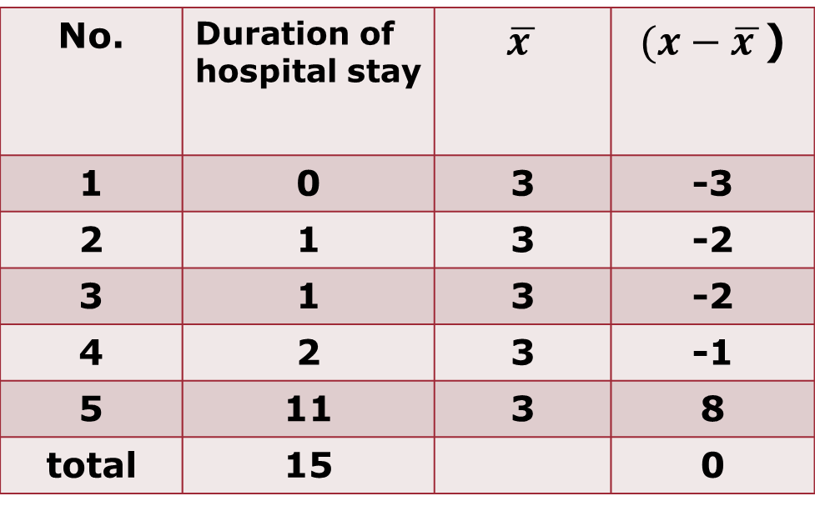
Example: These data show duration of hospital stay for 5 patients.
$(x−\overline{x }$) | $$\overline{x }$$ | Duration of hospital stay | No.
-3 | 3 | 0 | 1
-2 | 3 | 1 | 2
-2 | 3 | 1 | 3
-1 | 3 | 2 | 4
8 | 3 | 11 | 5
0 |  | 15 | total

Slide 4
The mean for the data
$\overline{x }$= 15/5 = 3 days
As a rule, the summation of differences away $from the mean = 0$
$$\sum{(x−\overline{x})}= 0$$
Measures of dispersion tell us “ how dispersed” the values are from their center .
Measures of dispersion are numerous, e.g.
Range , variance ($s^{2}$) , standard deviation $(s)$, coefficient of variation.

Slide 5
1- The Range
Range is the difference between the largest and smallest values , i.e. ,
Maximum value – minimum value
Example: No. of absence days of 5 students :
0, 1, 1, 2, 11.
Minimum= 0 days
Maximum= 11 days
Range : maximum – minimum = 11 – 0 = 11 days

Slide 6
2- The variance
Variance ($s^{2}$) can be calculated as follows:
$s^{2}$= $\frac{\sum{{(x−\overline{x})}^{2}}}{n−1}$ or $s^{2}$= $\frac{\sum{{x_{i}}^{2}−n{\overline{x}}^{2}}}{n−1}$
Units of variance are the squared units of measurement .

Slide 7
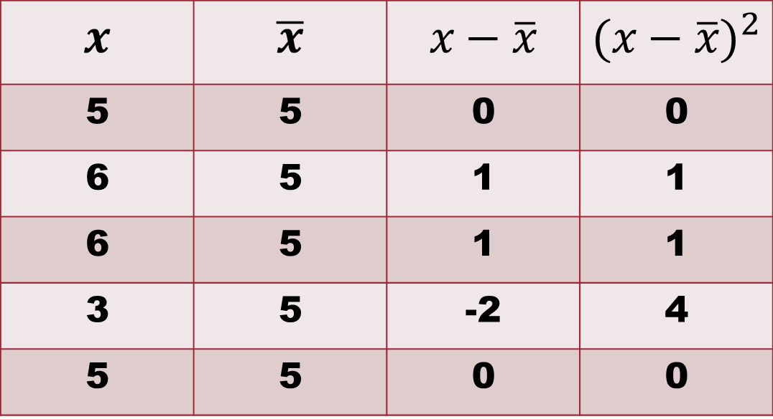
Example: These data show the weight ($x$) of 5 children (in kg):
$${(x−\overline{x})}^{2}$$ | $$x−\overline{x}$$ | $$\overline{x}$$ | $$x$$
0 | 0 | 5 | 5
1 | 1 | 5 | 6
1 | 1 | 5 | 6
4 | -2 | 5 | 3
0 | 0 | 5 | 5

Slide 8
Mean weight for these children = $\frac{25}{5}$
= 5 kg
$\sum{(x−\overline{x})}$= 0
$\sum{{(x−\overline{x})}^{2}}$= 6 kg²
$$n−1 = 5−1 = 4$$
Variance = $\frac{\sum{{(x−\overline{x})}^{2}}}{n−1}$ = 6/4 = 1.5 kg²

Slide 9
3-The standard Deviation (s)
Standard deviation (s) is the square root of the variance.
Units of the standard deviation are the same units of measurement.
The standard deviation can be calculated as follows:
$$s=\sqrt{\frac{\sum{{(x−\overline{x})}^{2}}}{n−1}}$$

Slide 10
Example: These data show the weight (x) of 5 children (in kg):

Slide 11

Variance ($s^{2}$) = 1.5 kg²
Standard deviation (s) = $\sqrt{1.5 }$ kg = 1.22 kg

Slide 12
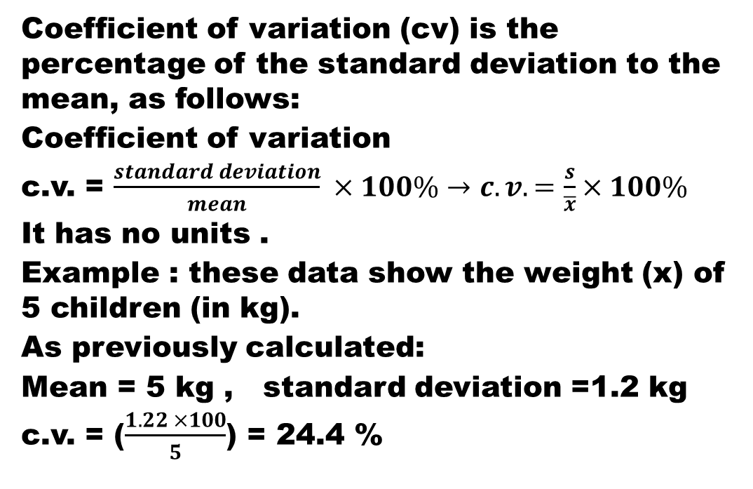
4-Coefficient of variation
Coefficient of variation (cv) is the percentage of the standard deviation to the mean, as follows:
Coefficient of variation
c.v. = $\frac{standard deviation}{mean} ×100\%→c.v.=\frac{s}{\overline{x}}×100\%$
It has no units .
Example : these data show the weight (x) of 5 children (in kg).
As previously calculated:
Mean = 5 kg , standard deviation =1.2 kg
c.v. = ($\frac{1.22 ×100}{5}$) = 24.4 %

Slide 13
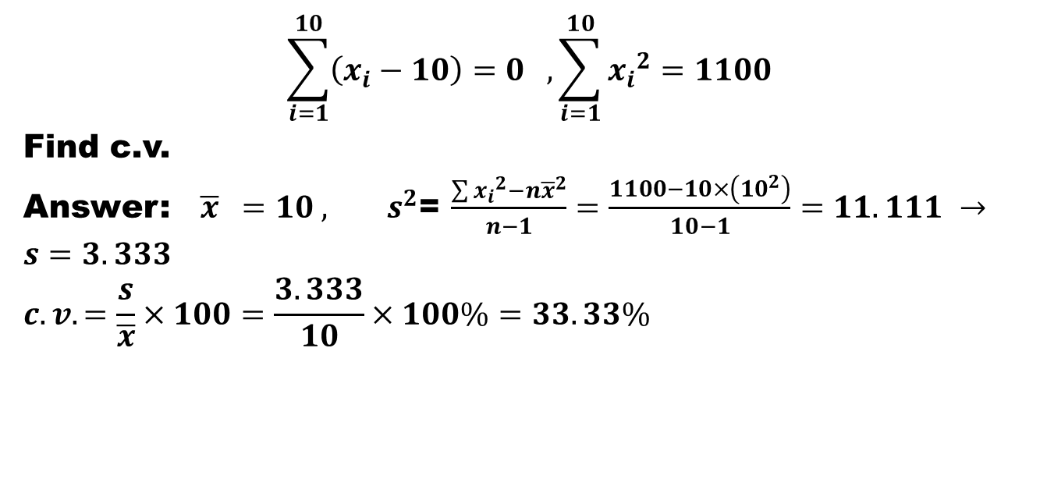
Example: if it was
$$\sum_{i=1}^{10}{\left(x_{i}−10\right)=0 , \sum_{i=1}^{10}{{x_{i}}^{2}=1100}}$$
Find c.v.
Answer: ${ \overline{x} =10 , s}^{2}$= $\frac{\sum{{x_{i}}^{2}−n{\overline{x}}^{2}}}{n−1}=\frac{1100−10×\left({10}^{2}\right)}{10−1}=11.111 →$
$$s=3.333$$
$$c.v.=\frac{s}{\overline{x}}×100=\frac{3.333}{10}×100\%=33.33\%$$

Slide 14
Homework: If you know that the sum of the squares of the deviations of values ​​from their mean for ten values ​​is 82.665, calculate the variance.

